Slide 1
Presentataion by
Mary Balemba
Jan 19th, 2025
ITAI-1378 Computer Vision
Computer Vision -Historical Timeline of Computer Vision

Slide 2
1. Early Beginnings (1950s-1960s)
Imagine the 1950s, a time of burgeoning optimism and technological advancements. Scientists were captivated by the idea of creating machines that could "see" and understand the world around them, just like humans.
Focus: This era saw the first tentative steps, with researchers focusing on the most basic visual tasks. It was like a child learning to recognize shapes – identifying edges and distinguishing between light and dark areas in an image.
Key Figures:
Frank Rosenblatt: A visionary, Rosenblatt, much like an artist experimenting with new colors, sought to create a machine that could learn to recognize patterns. His creation, the Perceptron, was a rudimentary artificial neural network, a pioneering effort to mimic the human brain's ability to learn and adapt.
David Marr: A true intellectual, Marr approached computer vision from a more philosophical standpoint. He believed that understanding how humans perceive the world was crucial for building effective computer vision systems. He was a bit like a detective, meticulously piecing together the puzzle of human vision, emphasizing the importance of how we represent and interpret visual information.
Key Advancements:
The Perceptron, while relatively simple by today's standards, was a groundbreaking achievement. It was like the first spark of artificial intelligence, demonstrating that machines could be taught to recognize patterns.
Early work on edge detection and feature extraction was like teaching a child to recognize the outlines of shapes, laying the groundwork for more complex visual understanding.
Applications: These early efforts were limited, much like a child's first drawings – simple and focused on specific tasks. They found applications in areas like microscopy, where scientists needed to analyze images of tiny organisms, and in industrial automation, where machines needed to identify and sort objects on a production line.

Slide 3
2. Rise of Image Processing (1970s-1980s)
By the 1970s, computer vision research was gaining momentum, much like a teenager learning to ride a bike – becoming more confident and skilled.
Focus: The emphasis shifted towards more sophisticated techniques. Researchers began to develop more refined tools for analyzing images:
Edge detection: Imagine teaching a child to draw by first outlining the shapes. Edge detection algorithms, like the Sobel and Canny detectors, became more sophisticated, allowing computers to precisely identify the boundaries of objects within an image.
Feature extraction: This was like teaching a child to identify key features of a face – eyes, nose, mouth. Researchers developed methods to extract meaningful features from images, such as corners, lines, and curves, which provided a more comprehensive understanding of the visual scene.
Motion analysis: This was like teaching a child to follow a moving object with their eyes. Researchers explored techniques to track moving objects in video sequences, laying the foundation for applications in areas like surveillance and video analysis.
Key Figures:
David Marr continued his influential work, delving deeper into the mysteries of human vision, much like a seasoned artist exploring new techniques.
Shimon Ullman, a brilliant mathematician, developed the RANSAC algorithm. This was like developing a powerful tool that could help a child draw more accurately, allowing for robust estimation of model parameters, even in the presence of noisy or incomplete data.
Key Advancements:
The development of robust algorithms for edge detection and feature extraction was a significant milestone, much like a child mastering a new skill. These advancements provided a more accurate and reliable foundation for analyzing visual information.
Progress in motion analysis and tracking opened up new possibilities, much like a child learning to ride a bike and then exploring new terrains.

Slide 4
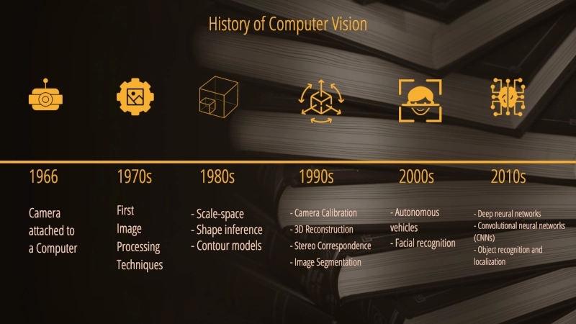
Image 1

Slide 5
3. The Rise of Machine Learning (1990s-2000s)
By the 1990s, computer vision was entering a new phase of maturity, much like a young adult entering college, ready to explore new ideas and expand their knowledge.
Focus: The emphasis shifted towards machine learning, a powerful approach that allowed computers to learn from data, much like a student learning from textbooks and lectures.
Statistical learning: Researchers began to use statistical models to identify patterns and relationships within visual data, much like a student analyzing data to draw conclusions.
Support Vector Machines (SVMs): These powerful algorithms, developed by Vladimir Vapnik, were like powerful tools that helped students effectively classify and categorize information.
Hidden Markov Models (HMMs): These models were used to understand sequences of events, much like a student analyzing the plot of a story. In computer vision, they were used to model temporal sequences, such as the movement of objects in a video.
Key Figures:
Vladimir Vapnik, a brilliant mathematician, developed the theory of Support Vector Machines, providing computer vision with a powerful new tool for classification.
Andrew Ng, a pioneer in the field of machine learning, played a crucial role in advancing the field and exploring its applications in computer vision.
Key Advancements:
The development of powerful machine learning algorithms, such as SVMs and HMMs, significantly improved the accuracy and efficiency of computer vision systems. It was like providing students with access to a library of powerful research tools.
These advancements led to significant improvements in object recognition and classification tasks, allowing computers to accurately identify and categorize objects within images and videos, much like a student mastering a new subject.
Applications: The applications of computer vision began to expand rapidly, much like a college graduate exploring new career paths. It found applications in face recognition, object detection, and image retrieval, transforming fields like security, surveillance, and entertainment.

Slide 6
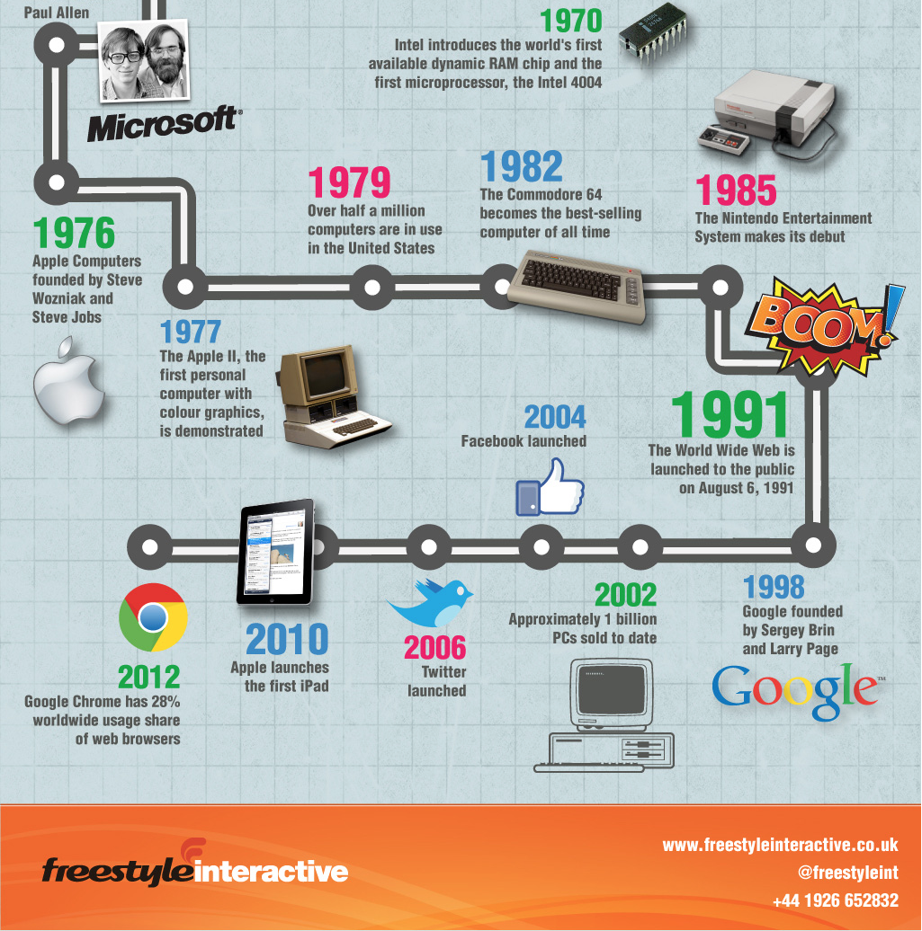
Image 2

Slide 7
4. The Deep Learning Revolution (2010s-Present)
The 2010s witnessed a true revolution in computer vision, much like a scientific breakthrough that changes the course of history.
Focus: The rise of deep learning, particularly Convolutional Neural Networks (CNNs), transformed computer vision in unprecedented ways. It was like a scientific revolution, unlocking new possibilities and pushing the boundaries of what was thought to be achievable.
Key Figures:
Geoffrey Hinton, a visionary researcher, played a pivotal role in the development of deep learning, much like a pioneering scientist leading a scientific revolution.
Yann LeCun, a pioneer in the field of convolutional neural networks, laid the foundation for many of the breakthroughs in deep learning.
Key Advancements:
The development of deep learning architectures, such as AlexNet, VGGNet, and ResNet, was a major breakthrough. These powerful networks achieved state-of-the-art performance in image classification, object detection, and other tasks, much like a scientific breakthrough that surpasses all previous achievements.
The emergence of large-scale datasets, such as ImageNet, provided deep learning models with the vast amounts of data they needed to learn and improve, much like a student having access to a vast library of knowledge.
Applications: The impact of deep learning on computer vision has been profound, transforming numerous fields and driving innovation:
Self-driving cars are becoming a reality, relying heavily on computer vision systems to perceive and navigate the world.
Facial recognition systems are now widely used in various applications, from unlocking phones to identifying individuals in crowds.
Medical image analysis is being revolutionized by deep learning, enabling more accurate diagnosis and treatment of diseases.

Slide 8
Continuation of 4. The Deep Learning Revolution (2010s-Present)
Perceptron: This early neural network, much like the first spark of a fire, laid the foundation for all subsequent neural network-based computer vision systems.
Edge detection and feature extraction algorithms: These algorithms, much like the tools of a skilled craftsman, enabled more accurate and robust analysis of visual information.
Machine learning algorithms: These algorithms, much like a student's growing knowledge base, improved accuracy and efficiency in various computer vision tasks.
Deep learning: This revolutionary technology, much like a scientific breakthrough, has transformed computer vision, enabling unprecedented levels of accuracy and performance.

Slide 9
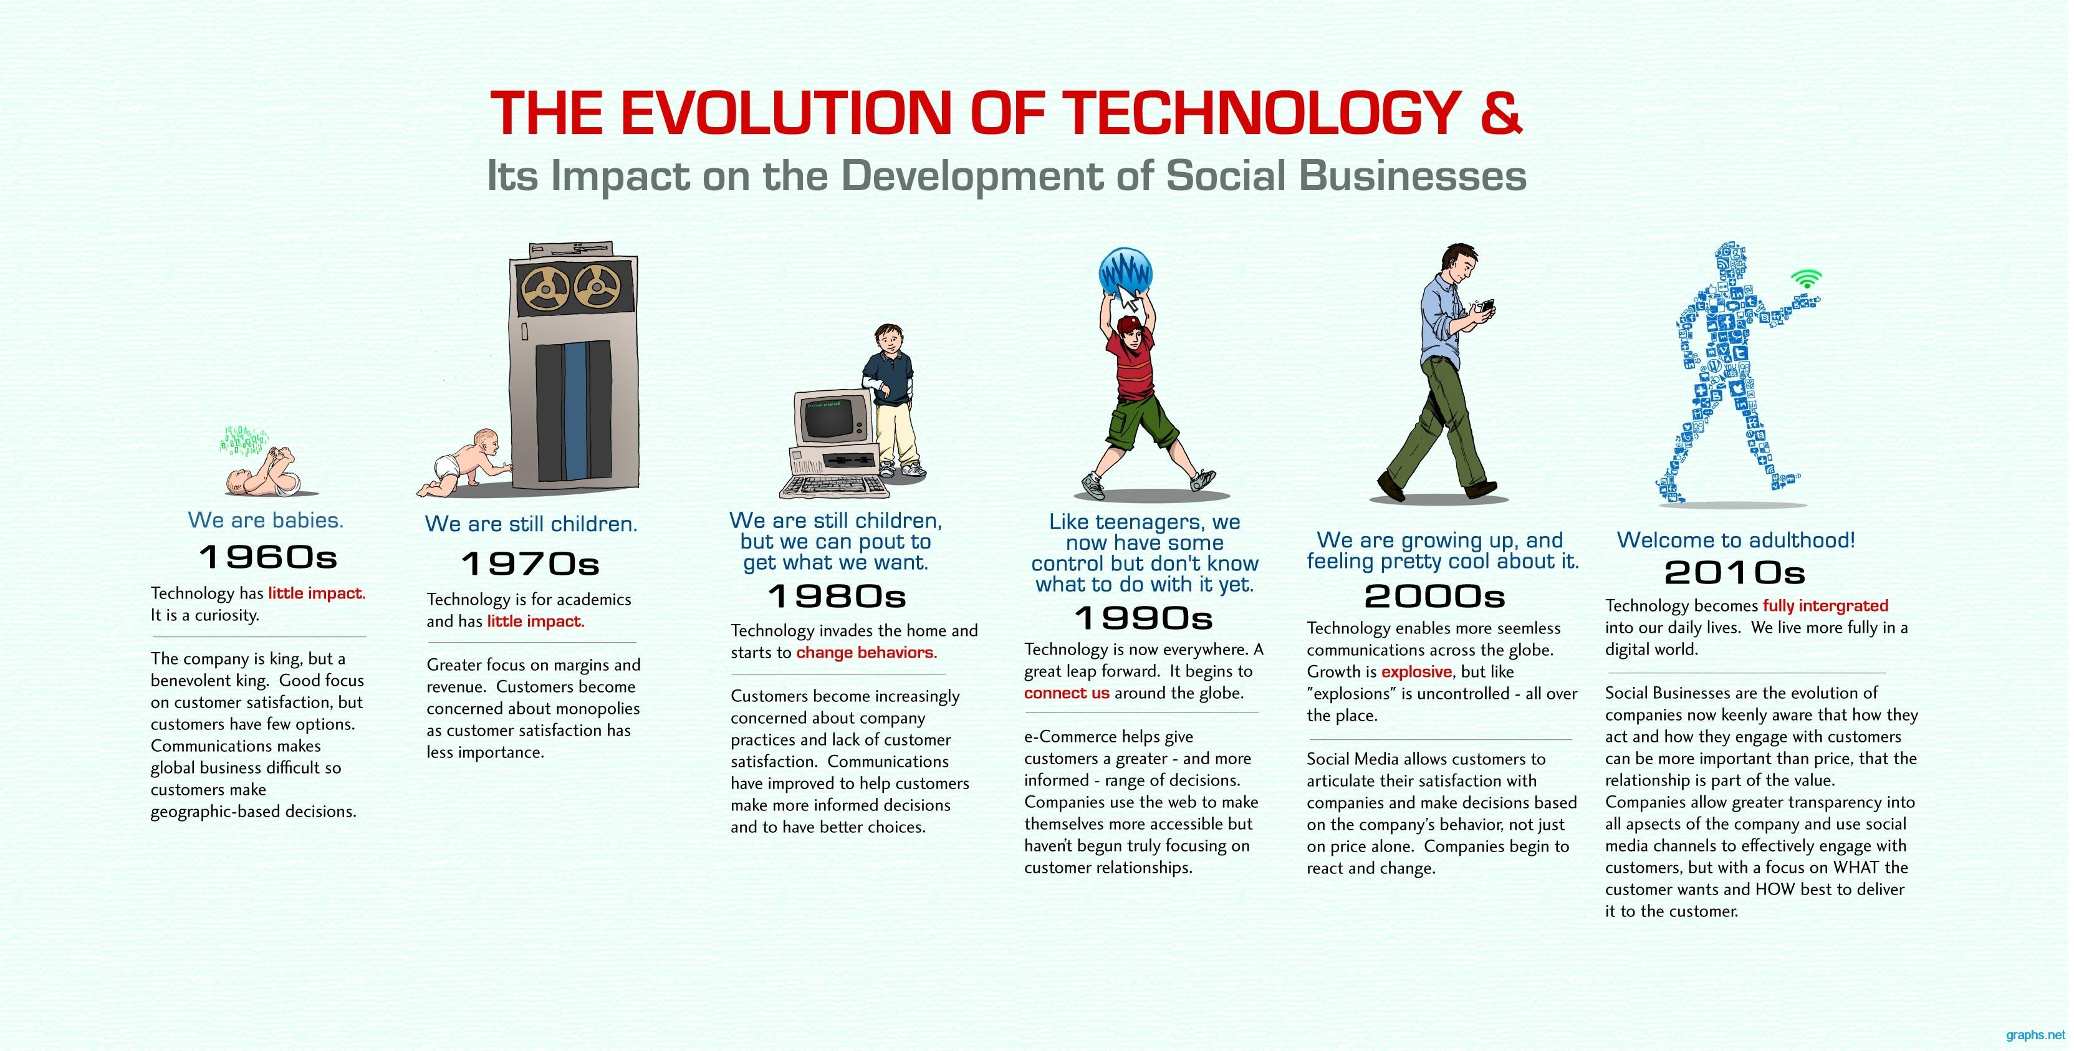
Image 3

Slide 10
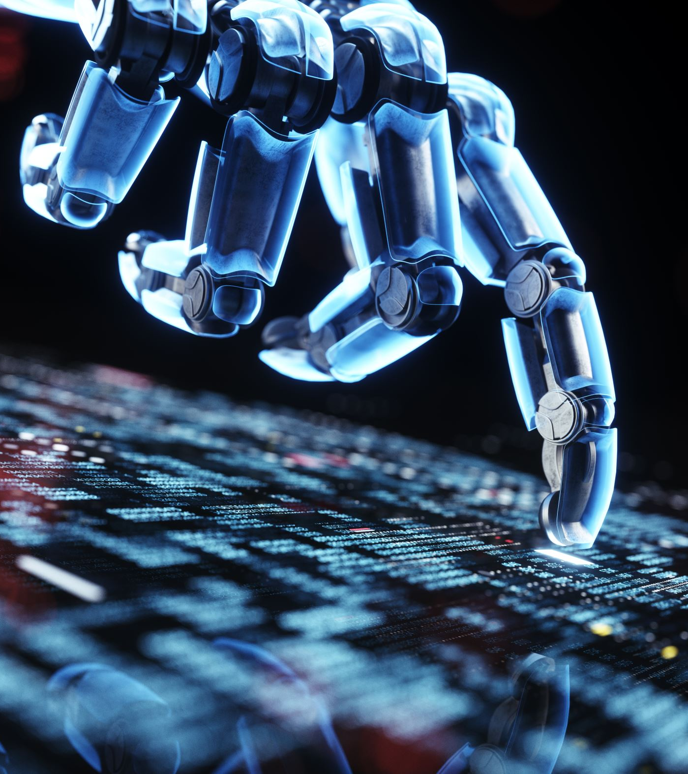
Conclusion
The history of computer vision is a fascinating journey of human ingenuity and scientific discovery. From its humble beginnings in the mid-20th century to the current era of deep learning, computer vision has evolved from a nascent field to a powerful technology that is transforming our world. It is a testament to the human capacity for innovation and our relentless pursuit of understanding the world around us.

Slide 11
References
Ballard DH, Zhang R. The Hierarchical Evolution in Human Vision Modeling. Top Cogn Sci. 2021 Apr;13(2):309-328. doi: 10.1111/tops.12527. Epub 2021 Apr 10. PMID: 33838010; PMCID: PMC9462461.
https://medium.com/data-and-beyond/a-historical-investigation-into-the-beginning-of-computer-vision-8e86858254bd#:~:text=It%20was%20concluded%20that%20the,that%20attempt%20to%20mimic%20natural
https://news.cornell.edu/stories/2019/09/professors-perceptron-paved-way-ai-60-years-too-soon#:~:text=%E2%80%9CThe%20perceptron%20was%20the%20first,perceptron%20in%20his%20Introduction%20to
https://blog.roboflow.com/edge-detection/

